Slide 1
Naive Bayes Classifier
Mohammed Munavar

Slide 2
Introduction
Definition: Naive Bayes is a probabilistic classifier based on Bayes' Theorem, used for classification tasks.
Purpose: It predicts the probability of each class label given the input features.

Slide 3
Why Bayes' Theorem?
Bayes' Theorem: Provides a principled way of calculating conditional probabilities.
Importance: Enables updating prior beliefs with new evidence to obtain posterior probabilities.

Slide 4
Posteriors and Priors
Prior Probability (Priors): Probability assigned to an event before evidence is taken into account.
Posterior Probability (Posteriors): Probability of an event occurring after taking into account new evidence.

Slide 5
Example
Scenario: Classifying emails as "Spam" or "Not Spam".
Illustration: Prior probabilities and posterior probabilities calculation using Bayes' Theorem.

Slide 6
Types of Naive Bayes Classifiers
Gaussian Naive Bayes: Assumes features follow a Gaussian (normal) distribution.
Multinomial Naive Bayes: Suitable for features representing counts or frequencies.
Bernoulli Naive Bayes: Assumes binary features.

Slide 7
Working of Naive Bayes
Training Phase:
Calculate class priors (Priors) and conditional probabilities for each feature given the class.
Prediction Phase:
Calculate the posterior probability of each class using Bayes' Theorem.
Select the class with the highest posterior probability as the predicted class.

Slide 8
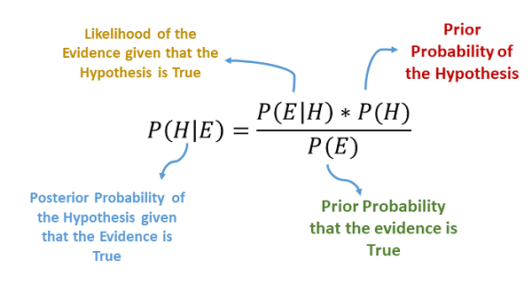
Working Formula with Example
Bayes' Theorem Formula :
Example: Calculating posterior probabilities for "Spam" and "Not Spam" classes given new email features

Slide 9
Advantages of Naive Bayes
Simplicity: Easy to implement and understand.
Efficiency: Requires a small amount of training data.
Versatility: Handles both categorical and numerical data efficiently.

Slide 10
Limitations of Naive Bayes
Strong Assumption: Assumes features are independent, which may not always hold true.
Inability to Learn Interactions: Unable to capture interactions between features.
Sensitivity to Irrelevant Features: Sensitive to irrelevant features in the dataset.

Slide 11
Applications of Naive Bayes
Email Spam Detection.
Text Classification (e.g., sentiment analysis, document categorization).
Medical Diagnosis.
Recommendation Systems.
Fraud Detection.

Slide 12
Conclusion
Recap: Naive Bayes Classifier is a powerful probabilistic algorithm used for classification tasks.
Despite its simplicity and assumptions, Naive Bayes performs well in various real-world applications.

